Slide 1
Inzulolwazi
OPENAI × ANDELA CAPSTONE · DISCOVERY AND AUDIENCE
House of knowledge: African history, told by Africans, with the evidence shown.
Simanga Mchunu · inzulolwazi-api.onrender.com
Notes:
Sawubona. My name is Simanga Mchunu, and this is inzulolwazi, isiZulu for house of knowledge.

Slide 2
Introduction
Africa is home to humanity’s oldest civilizations and its greatest diversity of cultures and languages. Yet much of its history online has been filtered through colonial narratives.
An evidence-first web app
Curated, not invented
English and isiZulu
Answers come only from a small, curated local knowledge base.
Shown side by side, with room to grow into more African languages.
Search African history and see the supporting evidence behind every claim.
Inzulolwazi · Introduction
Notes:
Africans should not have to take anyone’s word for their own past.

Slide 3
Problem statement
Outsider narration
Scattered sources
Claims outrun sources
Much written history came during or after colonial rule. Labels like “Bantu” began as scholars’ categories.
Evidence sits in journals, museums, archives and oral traditions that ordinary people struggle to reach.
Young people search online and on social media, where claims travel faster than verified knowledge.
English-only
Unsourced AI
The real question
Most resources exclude millions of isiZulu and other native-language speakers.
Many AI tools give confident answers without showing where a claim comes from.
Not only what happened, but who says so, and what is the evidence?
Inzulolwazi · Problem statement
Notes:
Labels such as Bantu began as scholars’ categories, and today the word is regarded as offensive in South Africa. Khoisan is still argued over.

Slide 4
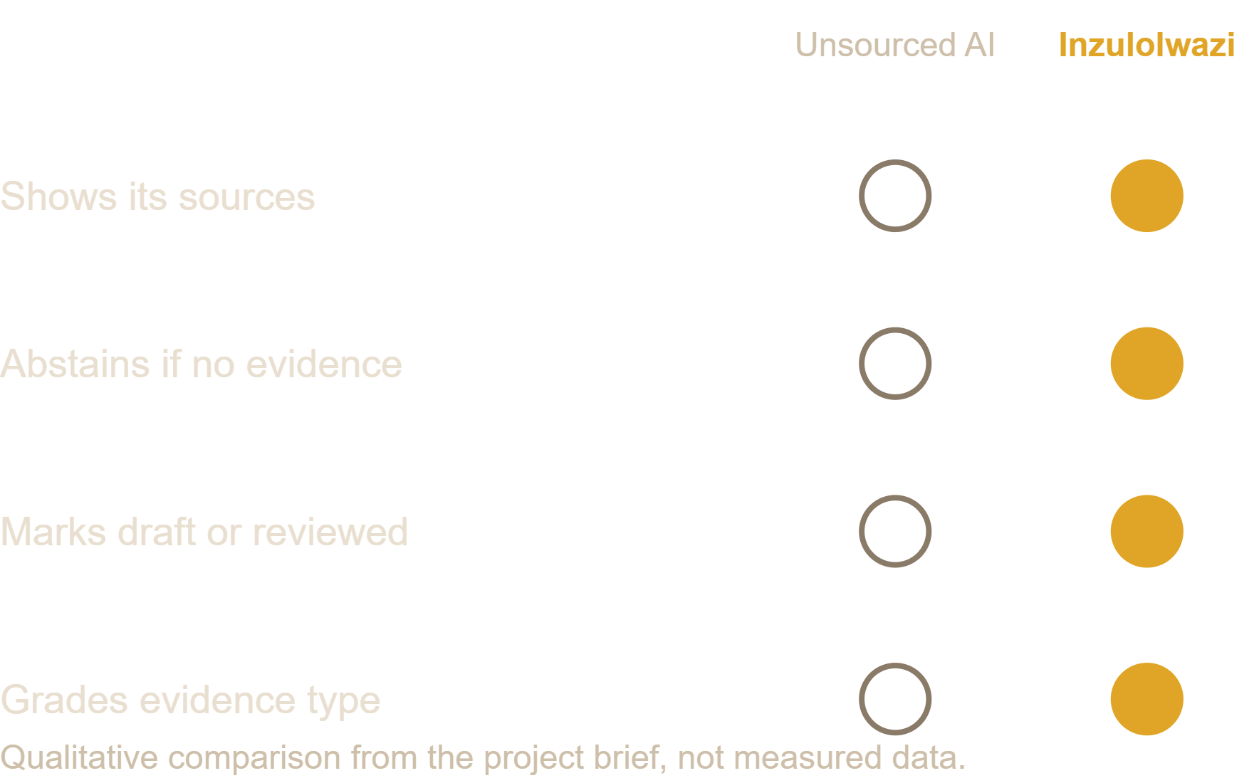
Data analysis
Historical perspective
Records produced under colonial administration are valuable, but reflect outside priorities. Oral traditions get less visibility.
Digital knowledge gap
Younger people use search and AI first, yet many tools hide the evidence behind answers.
Opportunity
Africa’s young population can gain historical literacy through transparent, multilingual tools.
Inzulolwazi · Data analysis
Notes:
The chart is a qualitative comparison drawn from the project brief, not measured data.

Slide 5
Solution
Search a topic like “Bantu” or “Great Zimbabwe” and get topics with their evidence, terms with history notes, and a searchable timeline. Search is local keyword matching, so every result traces to a source.
Cite or abstain
African-centred reading
Honest status
If there is no source, the app says so.
Colonial material appears only as what outsiders claimed, labelled as such.
Today every topic is a research lead, not a settled answer.
English with isiZulu beside it, labelled machine translated until a fluent speaker reviews it. An open API lets schools and apps build on it.
Inzulolwazi · Solution
Notes:
Live demo: type Bantu, open a topic, scroll to the evidence, checklist and citation box, then switch to isiZulu.

Slide 6
Goal and conclusion
Make African history searchable, transparent and available in our own languages.
1
Historians and elders contribute
Not to replace historians, but to amplify them. Today it is a proof of concept: a handful of sourced topics in English and isiZulu, live on the web.
2
Oral testimony, shared with consent, as first-class evidence
3
isiXhosa, Sesotho and Setswana
African history, told by Africans, with the evidence shown. Ngiyabonga.
inzulolwazi-api.onrender.com
Notes:
A young person who searches for their history should find what the evidence says, shown openly, in a language they grew up speaking.

